Slide 1
McCall’s Software Quality Model, ISO 9126 and CMM Model

Slide 2
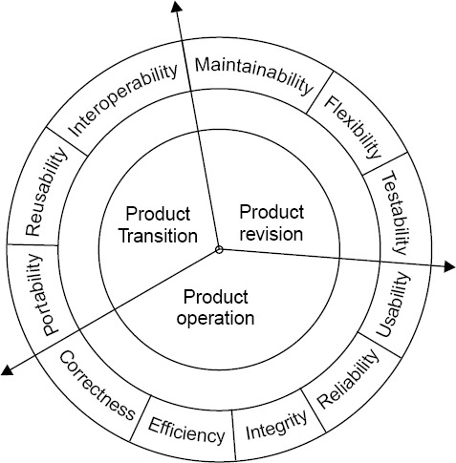
McCall Software Quality Model
McCall Software Quality Model
Fig 7.9: Software quality factors

Slide 3
McCall Software Quality Model
i. Product Operation
Factors which are related
to the operation of a product are
combined. The factors are:
Correctness
Efficiency 
Integrity
Reliability
Usability
These five factors are related to operational performance, convenience, ease of usage and its correctness. These factors play a very significant role in building customer’s satisfaction.

Slide 4
McCall Software Quality Model
ii. Product Revision
The factors which are required for testing & maintenance are combined and are given below:
Maintainability
Flexibility
Testability
These factors pertain to the testing & maintainability of software. They give us idea about ease of maintenance, flexibility and testing effort. Hence, they are combined under the umbrella of product revision.

Slide 5
McCall Software Quality Model
iii. Product Transition
We may have to transfer a product from one platform to an other platform or from one technology to another technology. The factors related to such a transfer are combined and given below:
Portability
Reusability
Interoperability

Slide 6
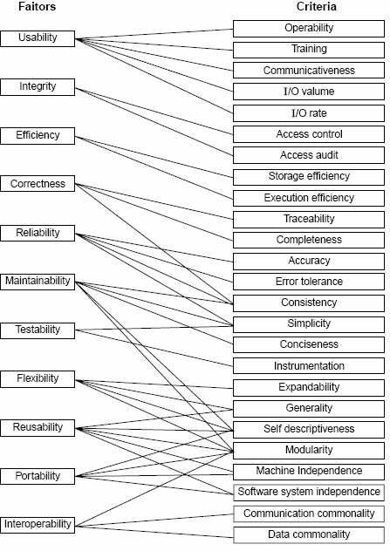
Quality criteria
Fig 7.10: McCall’s quality model

Slide 7
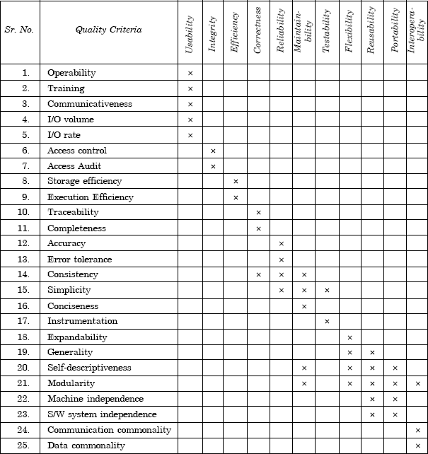
McCall Software Quality Model
Table 7.5(a): Relation between quality factors and quality criteria

Slide 8
McCall Software Quality Model
1 | Operability | The ease of operation of the software.
2 | Training | The ease with which new users can use the system.
3 | Communicativeness | The ease with which inputs and outputs can be assimilated.
4 | I/O volume | It is related to the I/O volume.
5 | I/O rate | It is the indication of I/O rate.
6 | Access control | The provisions for control and protection of the software and data.
7 | Access audit | The ease with which software and data can be checked for compliance with standards or other requirements.
8 | Storage efficiency | The run time storage requirements of the software.
9 | Execution efficiency | The run-time efficiency of the software.

Slide 9
McCall Software Quality Model
10 | Traceability | The ability to link software components requirements. | to
11 | Completeness | The degree to which a full implementation of required functionality has been achieved. | the
12 | Accuracy | The precision of computations and output.
13 | Error tolerance | The degree to which continuity of operation is ensured under adverse conditions.
14 | Consistency | The use of uniform design and implementation techniques and notations throughout a project.
15 | Simplicity | The ease with which the software can be understood.
16 | Conciseness | The compactness of the source code, in terms of lines of code.
17 | Instrumentation | The degree to which the software provides measurements of its use or identification of errors. | for

Slide 10
McCall Software Quality Model
18 | Expandability | The degree to which storage requirements or software functions can be expanded.
19 | Generability | The breadth of the potential application of software components.
20 | Self- descriptiveness | The degree to which the documents are self explanatory.
21 | Modularity | The provision of highly independent modules.
22 | Machine independence | The degree to which software is dependent on its associated hardware.
23 | Software system independence | The degree to which software is independent of its environment.
24 | Communication commonality | The degree to which standard protocols and interfaces are used.
25 | Data commonality | The use of standard data representations.
Table 7.5 (b): Software quality criteria

Slide 11
ISO 9126
Was standardized in 1992. Provides a single model to standardise the quality factors. Identifies following six factors for quality
Functionality
Reliability
Usability
Efficiency
Maintainability
Portability

Slide 12

ISO 9126
Characteristic/ Attribute | Short Description of the Characteristics and the concerns Addressed by Attributes
Functionality | Characteristics relating to achievement of the basic purpose for which the software is being engineered
Suitability | The presence and appropriateness of a set of functions for specified tasks
Accuracy | The provision of right or agreed results or effects
Interoperability | Software’s ability to interact with specified systems
Security | Ability to prevent unauthorized access, whether accidental or deliberate, to program and data.
Reliability | Characteristics relating to capability of software to maintain its level of performance under stated conditions for a stated period of time
Maturity | Attributes of software that bear on the frequency of failure by faults in the software

Slide 13
ISO 9126
Fault tolerance | Ability to maintain a specified level of performance in cases of software faults or unexpected inputs
Recoverability | Capability and effort needed to reestablish level of performance and recover affected data after possible failure.
Usability | Characteristics relating to the effort needed for use, and on the individual assessment of such use, by a stated implied set of users.
Understandability | The effort required for a user to recognize the logical concept and its applicability.
Learnability | The effort required for a user to learn its application, operation, input and output.
Operability | The ease of operation and control by users.
Efficiency | Characteristic related to the relationship between the level of performance of the software and the amount of resources used, under stated conditions.

Slide 14
ISO 9126
Time behavior | The speed of response and processing times and throughout rates in performing its function.
Resource behavior | The amount of resources used and the duration of such use in performing its function.
Maintainability | Characteristics related to the effort needed to make modifications, including corrections, improvements or adaptation of software to changes in environment, requirements and functions specifications.
Analyzability | The effort needed for diagnosis of deficiencies or causes of failures, or for identification of parts to be modified.
Changeability | The effort needed for modification, fault removal or for environmental change.
Stability | The risk of unexpected effect of modifications.
Testability | The effort needed for validating the modified software.

Slide 15
ISO 9126
Portability | Characteristics related to the ability to transfer the software from one organization or hardware or software environment to another.
Adaptability | The opportunity for its adaptation to different specified environments.
Installability | The effort needed to install the software in a specified environment.
Conformance | The extent to which it adheres to standards or conventions relating to portability.
Replaceability | The opportunity and effort of using it in the place of other software in a particular environment.
Table 7.6: Software quality characteristics and attributes – The ISO 9126 view

Slide 16
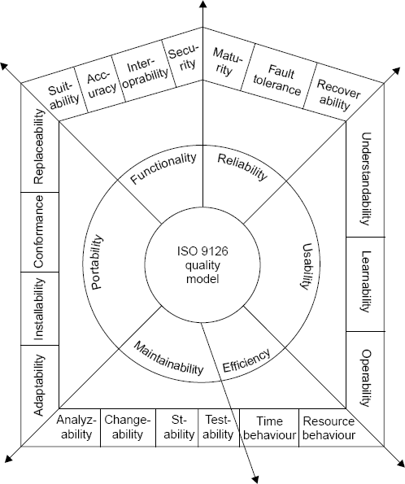
ISO 9126
Fig.7.12: ISO 9126 quality model

Slide 17
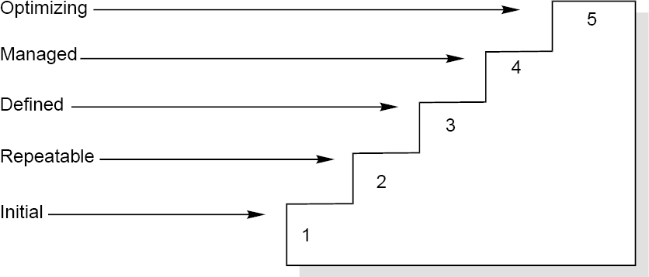
Capability Maturity Model
Capability Maturity Model
It is a strategy for improving the software process, irrespective of the actual life cycle model used.
Fig.7.23: Maturity levels of CMM

Slide 18
Capability Maturity Model
Maturity Levels:
Initial (Maturity Level 1)
Repeatable (Maturity Level 2)
Defined (Maturity Level 3)
Managed (Maturity Level 4)
Optimizing (Maturity Level 5)

Slide 19
Capability Maturity Model
Maturity Level | Characterization
Initial | Adhoc Process
Repeatable | Basic Project Management
Defined | Process Definition
Managed | Process Measurement
Optimizing | Process Control
Fig.7.24: The five levels of CMM

Slide 20
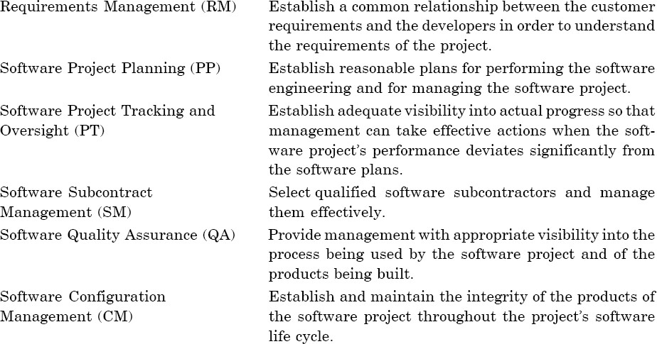
Capability Maturity Model
Key Process Areas
The key process areas at level 2 focus on the software project’s concerns related to establishing basic project management controls, as summarized below:

Slide 21
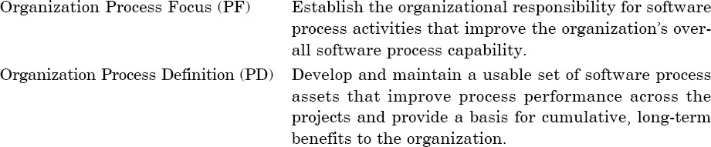
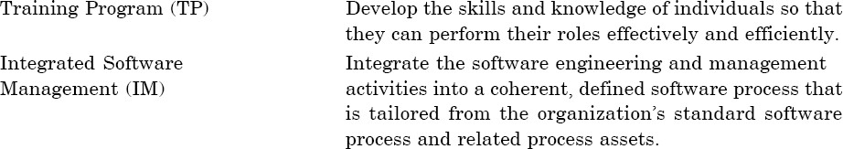
Capability Maturity Model
The key process areas at level 3 address both project and organizational issues, as summarized below:

Slide 22
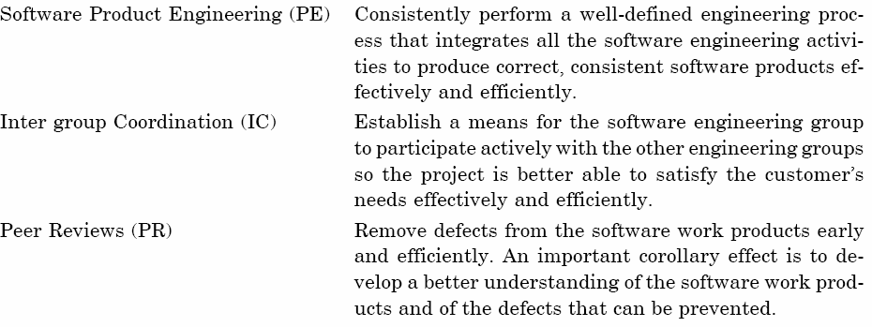
Capability Maturity Model

Slide 23
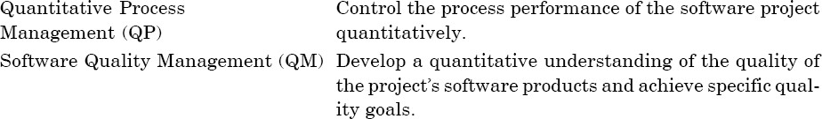
Capability Maturity Model
The key process areas at level 4 focus on establishing a quantitative understanding of both the software process and the software work products being built, as summarized below:

Slide 24
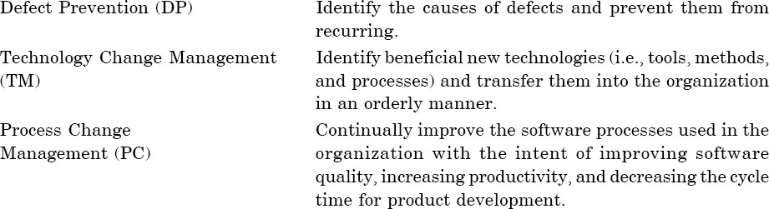
Capability Maturity Model
The key process areas at level 5 cover the issues that both the organization and the projects must address to implement continuous and measurable software process improvement, as summarized below:

